Slide 1

The new duty to prevent sexual harassment
The 8 steps employers need to take

Slide 2


Background
Women & Equalities Select Committee Inquiry - 2018
2019 Consultation
2021 Tackling Violence against Women & Girls
Unite v Nailard (2018)
Worker Protection etc Act 2024
in force 26 October 2024

Slide 3

What is the new duty?
Employers must take reasonable steps to prevent sexual harassment
‘worker-on-worker’ harassment
harassment by third parties
customers
clients
site visitors
patients
an ‘anticipatory’ duty
only applies to sexual harassment

Slide 4

What if we don’t comply?
Equality & Human Rights Commission
No free standing claim
If a worker has been sexually harassed:
Compensation can be increased by 25%
2023/4 – average award = £53,403
25% = £13,350
2023/4 – highest award = £995,128
25% = £248,782

Slide 5
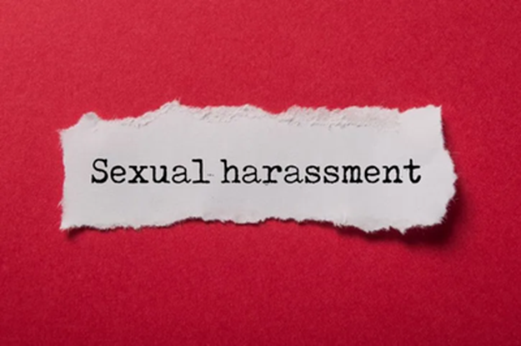
What is sexual harassment?
“unwanted conduct of a sexual nature which has the purpose or effect of violating someone’s dignity or creating an intimidating, hostile, degrading, humiliating or offensive environment for them”
“of a sexual nature” –v- sexually motivated
applies to someone of the same or a different sex
a comparator is not required
Employers are liable for harassment “in the course of employment”

Slide 6

spreading rumours
gestures
banter
mocking
being “touchy feely”
sexual advances
intrusive questions
touching, hugging
sexual favours
explicit texts/ emails
comments on social media
sexual jokes
rape
aggression
sexual images
suggestive looks/ leering

Slide 7
What is sexual harassment?
“less favourable treatment”
for rejecting…
… or submitting to ...
… unwanted conduct of a sexual nature…
… which violates the worker’s dignity…
… or creates a hostile etc environment

Slide 8

Addressing the preventative duty
Policy
Reporting
Training
Complaints
Third parties
Risk assess
Engage staff
Review & improve

Slide 9
Addressing the preventative duty
Step 1: Policy
Develop an effective anti-harassment policy
Specify who is protected
Sexual harassment will not be tolerated
Define sexual harassment and give examples
Set out a complaints procedure
Address third-party harassment
No time limit for complaints
Don’t over-emphasise vexatious complaints

Slide 10

Addressing the preventative duty
Step 2: Engagement
Engage your staff
Staff surveys, 1-2-1s, exit interviews
Understand:
Potential issues/ risks
If your actions are effective
Ensure workers are aware of
How to make a complaint
Your harassment policy and consequences of breaching it

Slide 11

Culture
“Stuff” – Policies, Posters, Comms
“Underlying conditions”
Education & awareness
Behaviours
Values
Psychological safety

Slide 12
Addressing the preventative duty
Step 3: Risk Assessment
Hazards
Identify the hazards
Assess the risks
Assessing the risks – urgency, severity, options
Controls
Implement control measures to eliminate or minimise risks
Review
Regular reviews to ensure effectiveness

Slide 13

Step 3: Risk Assessment
Risk areas/ potential hazards
Power imbalances
Lack of diversity
Vulnerable groups
Lone or night working
Customer contact/ profile
Expectation to attend external events
Alcohol
Office layout
“banter culture”
Open secrets

Slide 14

Addressing the preventative duty
Step 4: Reporting
What system is in place?
Is it adequate?
Are staff aware?
How could it be strengthened?
Awareness of sexual harassment
Other support mechanisms

Slide 15

Addressing the preventative duty
Step 5: Training
For all staff
What sexual harassment looks like
What to do if experienced
What to do if witnessed
How to make/ handle complaints
How to address third party harassment

Slide 16
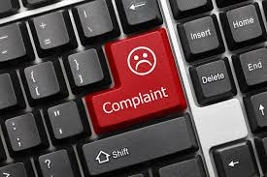
Addressing the preventative duty
Step 6: Complaints
Act immediately
Suspend/ separate?
Investigate
Respect complainant’s wishes
Ensure confidentiality
Consider Police involvement
Communicate the outcome

Slide 17

Addressing the preventative duty
Step 7: Third Party Harassment
Identify risk areas
Implement control mechanisms
Advise third parties of your approach
Reporting mechanisms
Investigate
Keep a log
Communicate the outcome

Slide 18

Addressing the preventative duty
Step 8: Review and monitor
Regular reviews
Lessons learned from complaints
Identifying trends or concerns
Inviting feedback
Is training up to date?
Take into account any workplace changes

Slide 19
Any questions?

